Slide 1
Windows Fundamentals
BOOTING PROCESS

Slide 2
Booting Process
Booting Process:
Booting process the computer loads the operating system to its memory and prepares it for use.
Types of Booting:
Cold boot
Warm boot

Slide 3
OVERALL BOOTING PROCESS
Booting process include following steps:
BIOS initialization
OS loader
Kernel initialization
Session initialization
Winlog initialization
Explorer initialization

Slide 4
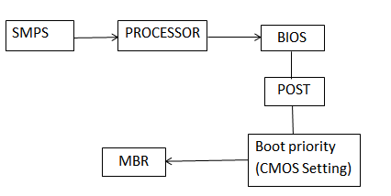
1.BIOS Initialization

Slide 5
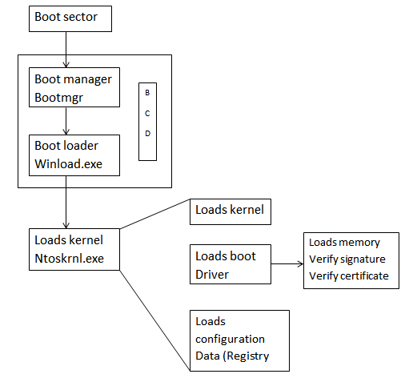
2. OS Loader

Slide 6
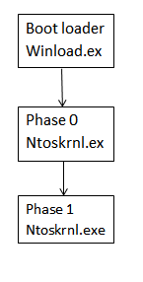
3. Kernel Initialization

Slide 7
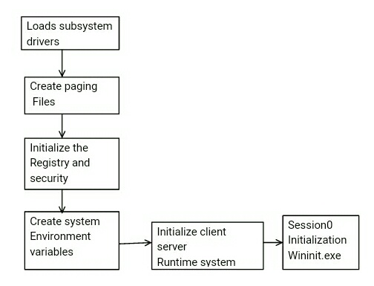
4.Session initialization

Slide 8
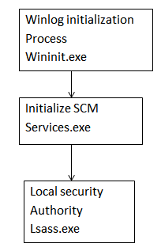
5.Winlog initialization

Slide 9
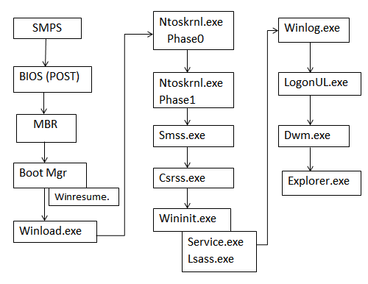
Booting Process

